Slide 1
eCommerceGAN
A Generative Adversarial Network for E-commerce
Sergey Sokolov
10-14 December 2018

Slide 2


Paper

Slide 3
Overview
Amazon, Alibaba, and Walmart typically process billions of orders every year.
Semantic representation and understanding of these orders is extremely critical for an eCommerce company
Order similarity
Recommendation
Forecasting
What is an order?
Each order can be represented as a tuple:
<customer, product, price, date>

Slide 4
Motivation
Amazon has billions of products in it’s inventory
The space of products is of much lower dimension
Inherent underlying structure imposed by product categories/subcategories etc.
Customers also belong to a lower dimension space
Grouped by purchase behavior, ethnicity, price/brand sensitivity
An “order” is an interaction from these two spaces
Only a subset of interactions are plausible
Plausible Order Examples:
Jazz aficionados won’t purchase heavy metal albums
A Vegan won’t purchase meat/diary products
Even a smaller subset of orders is actualized on Amazon!

Slide 5
Motivation
Exploring the space of plausible orders is important
Product Demands
Customer Preferences
Price Estimation
Seasonal Variations
These could directly or indirectly impact revenue and customer satisfaction
Authors proposed a variation of GAN for generating orders: eCommerceGAN

Slide 6
eCommerceGAN: Key contributions
Order embedding (order2vec)
ecGAN to generate plausible order
ec²GAN to generate orders conditioned on a product
Will be useful in estimating demand/price/customers-to-target
Several qualitative and quantitative approaches to evaluate the order generators

Slide 7
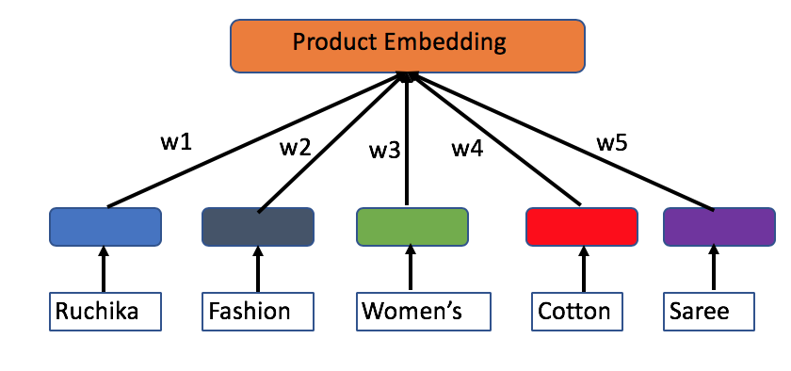
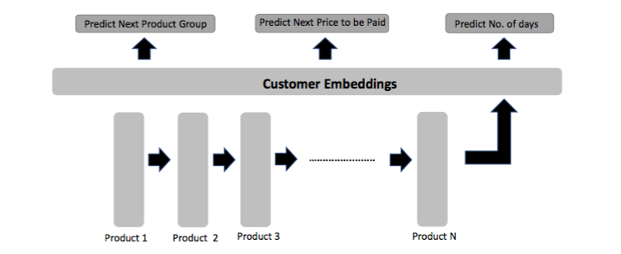
Representing an order
{Product, Customer, Price, Date}
Product Embeddings: 128 dimensional
Customer Embeddings: 128 dimensional
Price: Log transformed and normalized (1d)
Date (7 dimensional)
Day-of-week, day-of-month, month
Absolute time-difference from an epoch
Carefully crafted to capture the circularity of days and months
Projecting the days and months on a unit circle
Concatenate all the above to represent each order as a 264 dimensional feature

Slide 8
Generative adversarial networks

Slide 9
Wasserstein GAN (WGAN) [Arjovsky, 2017]
Variation of traditional GAN
Authors use improved training of WGAN (iWGAN) [Gulrajani, 2017]

Slide 10
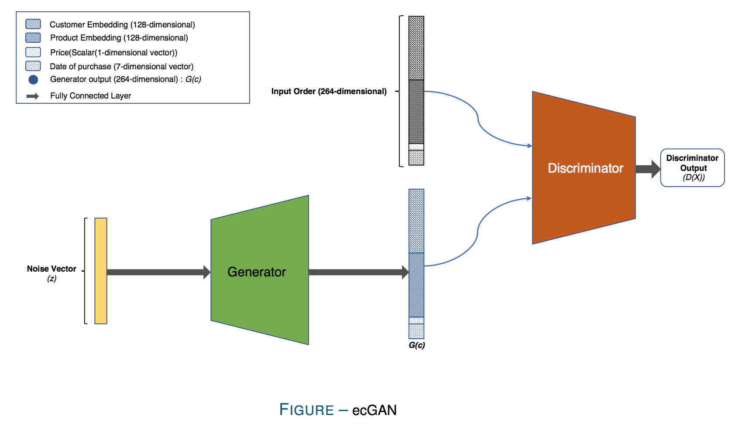
ecGAN

Slide 11
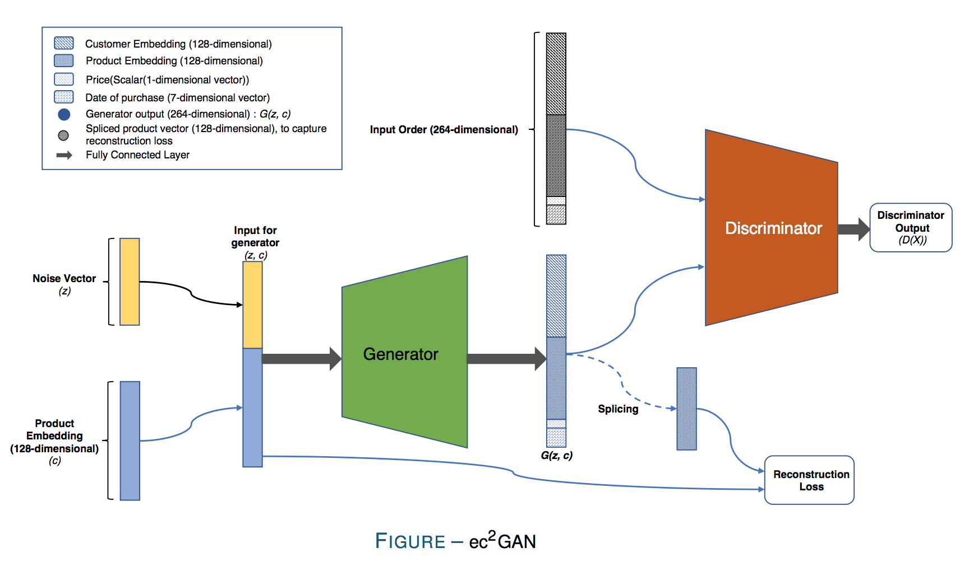
ec²GAN

Slide 12
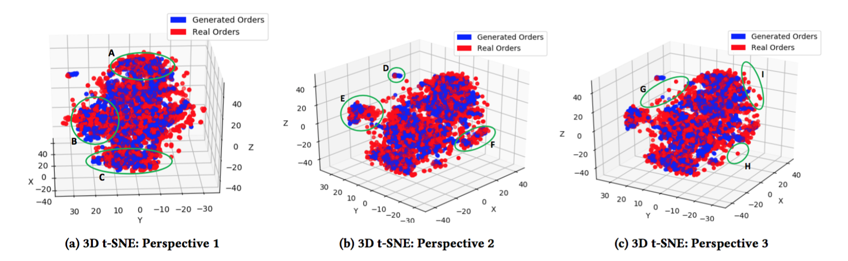
ecGAN: Qualitative Results
The real-orders and generated orders are mixed well
The generated order represents the true data distribution modes
The generated orders learned to ignore the “outlier” orders

Slide 13
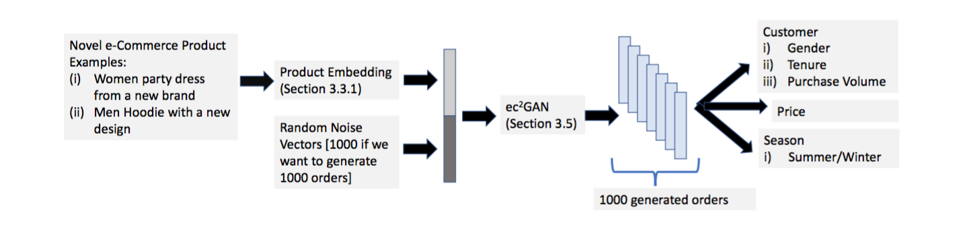
ec²GAN: Quantitative Analysis
Customer
Gender (Male, Female)
Tenure (High-tenured, Medium-tenured)
Purchase Volume (High Purchasers, Average Purchasers)
Price
Seasonal Demand
Summer (May, June, July, August)
Winter (November, December, January, February)

Slide 14
Evaluation Metric
Relative Similarity Score (RSM)
For each characteristic (such as male, female, average-purchaser):
Compute a propensity score corresponding to the generated orders
Compute a propensity score corresponding to the true orders
These scores enforce an ordering of products
The RSM measures an agreement between the generated orders and the true orders
Baseline RSM score for a random baseline: 50%
Baseline: Conditional Variational Autoencoder (C-VAE) based Order Generation

Slide 15
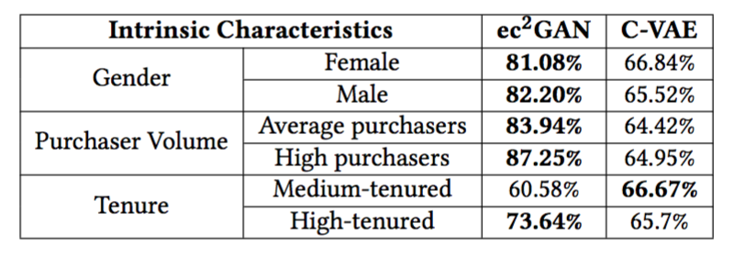
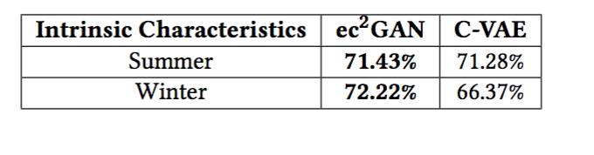
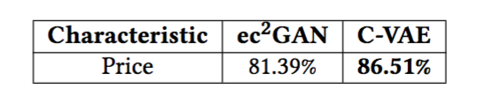
Results

Slide 16
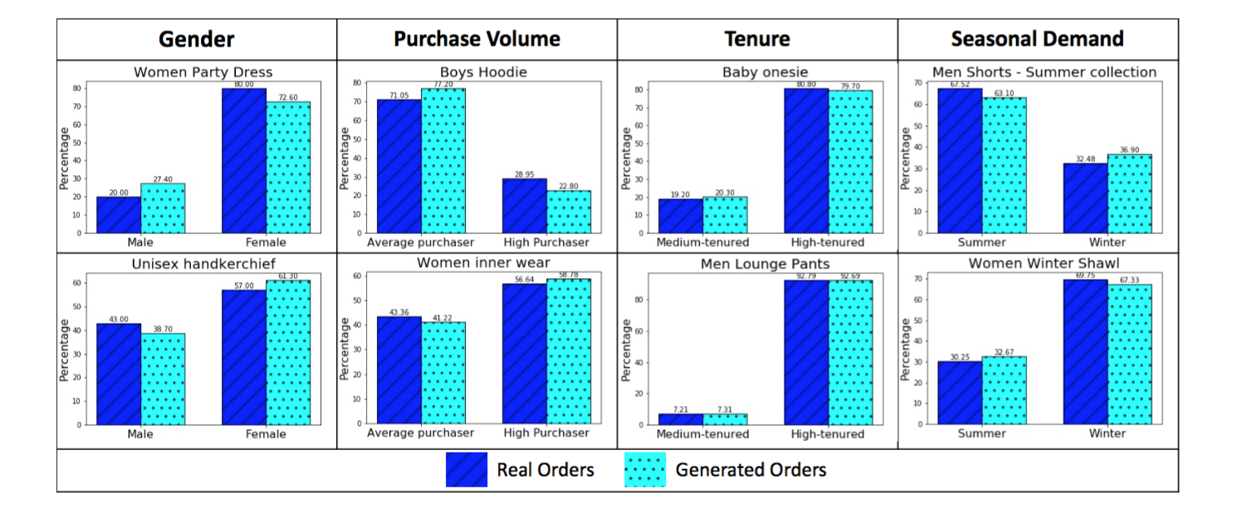

Slide 17
Questions?

